Slide 1
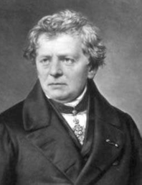
2.2 Electrical Resistance (Ohm’s)
Georg Simon Ohm, a German physicist who is famous for defining the fundamental relationship among voltage, current, and resistance through Ohm's law

Slide 2
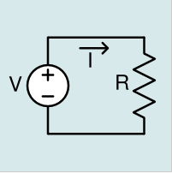

Ohm's law states that, in an electrical circuit, the current passing through a conductor, from one terminal point on the conductor to another terminal point on the conductor, is directly proportional to the potential difference (i.e. voltage drop or voltage) across the two terminal points and inversely proportional to the resistance of the conductor between the two terminal points
were
V = the voltage in volts (V)
I = the current in amperes (A)
R = the resistance in ohms (Ω)
Most materials exhibit measurable resistance to current. The amount of resistance depend on the material.
This is similar in some way when water flow in a pipe. If there is a dirt or material on the pipe it will impede ( يعيق) the flow of water.

Slide 3
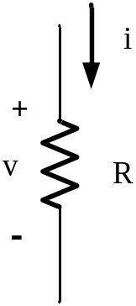
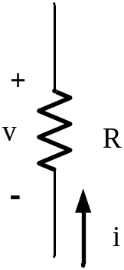
For purpose of circuit analysis, we must reference the current in the resistor to the terminal voltage. For the passive sign convention
v = Ri
Otherwise we introduce a minuses sign similar to what we did when we calculated power
v = − Ri

Slide 4
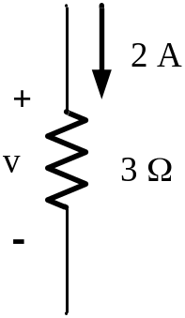
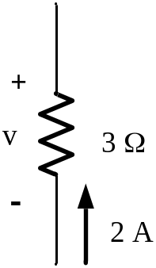
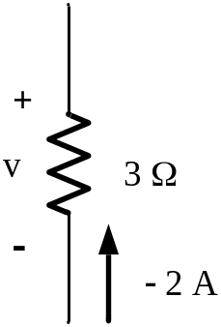
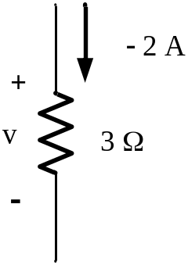
Example
v = −(3)(2) = −6 V
v = (3)(2) = 6 V
v = −(3)(− 2) = 6 V
v = (3)(− 2) = −6 V

Slide 5
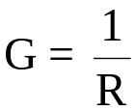

The reciprocal of resistance (مقاومه) is conductance (موصل) and have the symbol G
and have the unit S for (siemens) or for (mho) is spelling backward for ohm
An 8 Ω resistor is equivalent to 1/8= 0.125 S or

Slide 6
We may calculate the power at the terminal of a resistor in several way
First method : we use the defining equation as follows:
p = vi
For the passive sign convention
Otherwise we introduce a minus sign
p = −vi

Slide 7
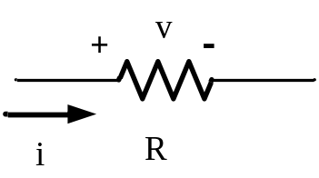


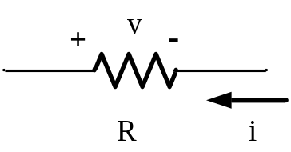


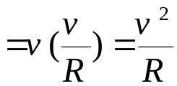
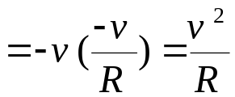
Second method : we express the power at the terminal of resistor in terms of the current and resistor as follows:
For the non passive sign convention we have
Third method : we express the power at the terminal of resistor in terms of the voltage and resistor as follows:
For the non passive sign convention we have

Slide 8

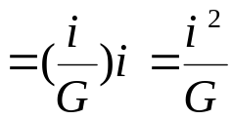

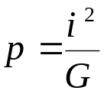
Fourth method : we express the power at the terminal of resistor in terms of the voltage or current and conductance G as follows:
For the non passive sign convention we will have identical relation as the passive sign convention

Slide 9
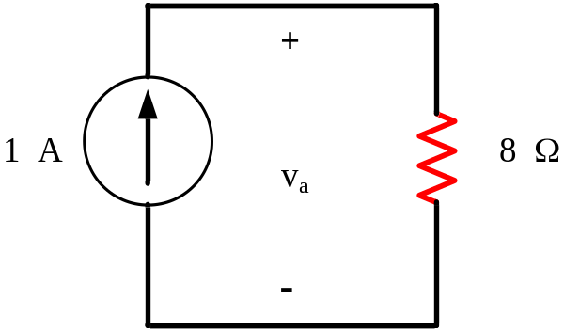



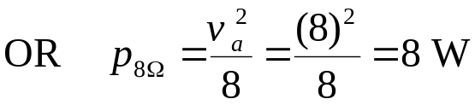
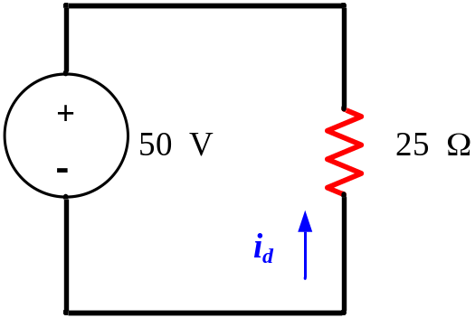

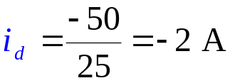

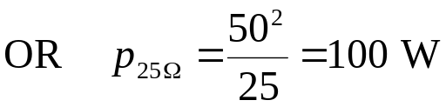
Example 2.3 In each circuit find the followings:

